Slide 1
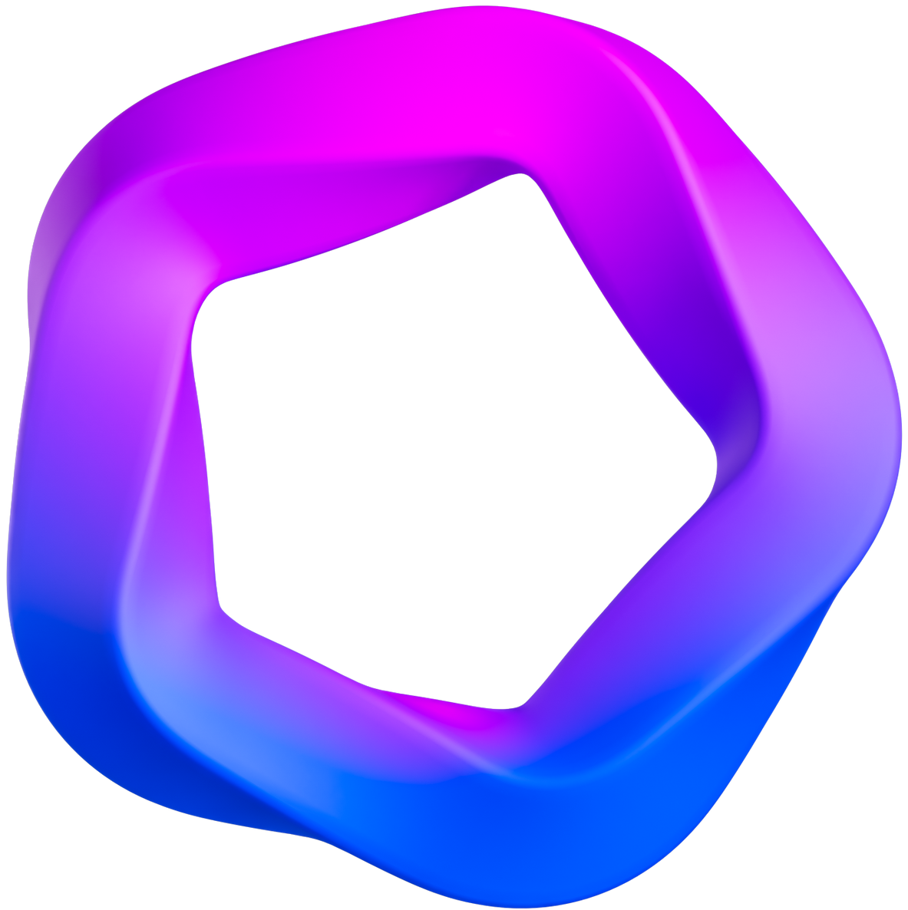

Team Krantiveer
presents
Patient-Centric Data Management
Guardian of Your Health Data

Slide 2


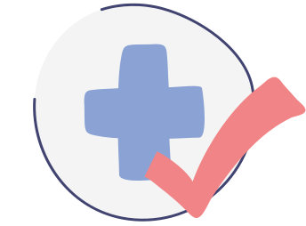
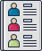
Problem Statement
Why there’s need?
In recent years, the healthcare industry has witnessed a concerning surge in data breaches and privacy violations, which has raised alarm bells regarding the security and integrity of patients' sensitive information.
Instances of unauthorized access to medical records, prescription data theft, and the proliferation of healthcare-related spam have highlighted a significant problem in the current healthcare ecosystem.
These security breaches not only jeopardize patients' personal and medical data but also erode trust in healthcare institutions and professionals.
In a world where our health is at stake, can we afford to
compromise on data security?
Our mission is to address this pressing issue head-on.
Stay tuned to learn how we plan to empower patients and fortify data security.

Slide 3
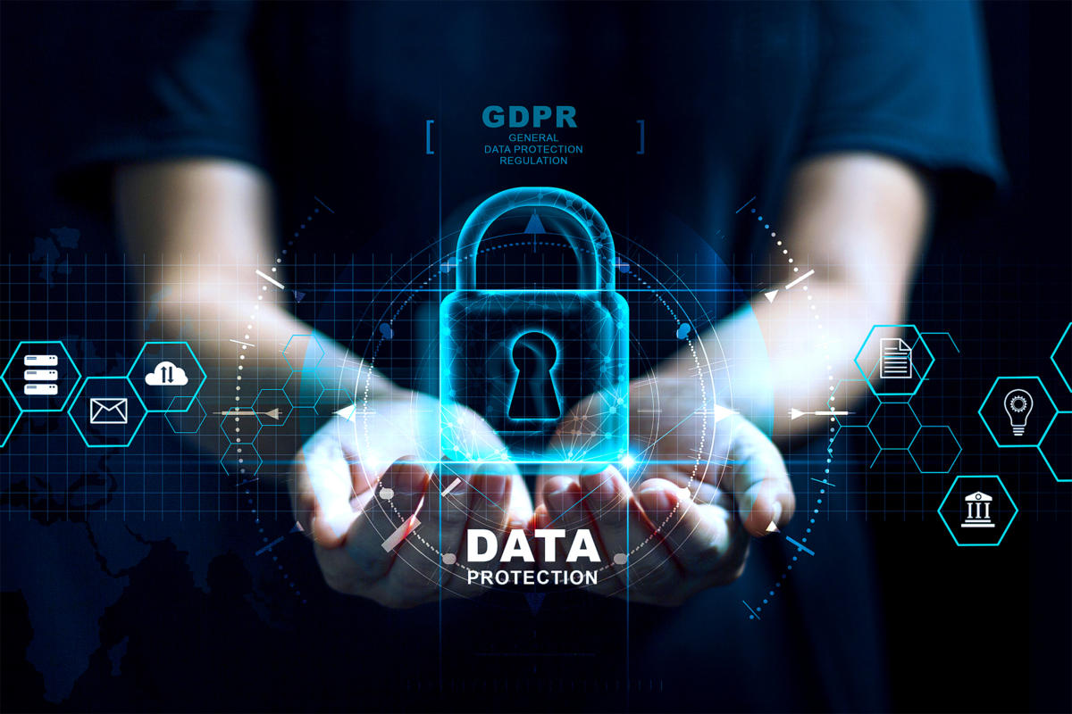
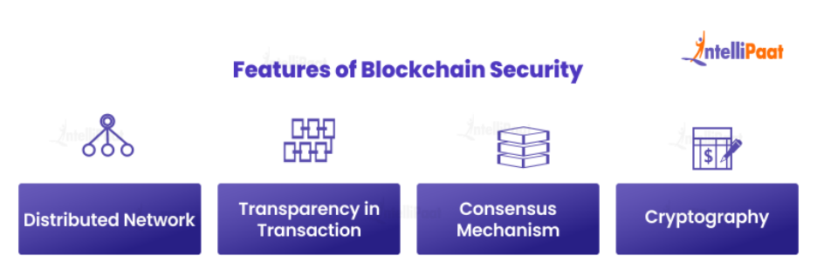
What we’re gonna do?
In light of the growing concerns over healthcare data security and privacy, we propose the development of a Patient-Centric Access system using blockchain technology.
This innovative solution aims to tackle the pressing issue of data breaches and privacy violations by providing patients with a secure, efficient, and streamlined means to access and share their healthcare information with authorized healthcare providers.

Slide 4

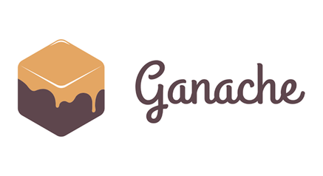
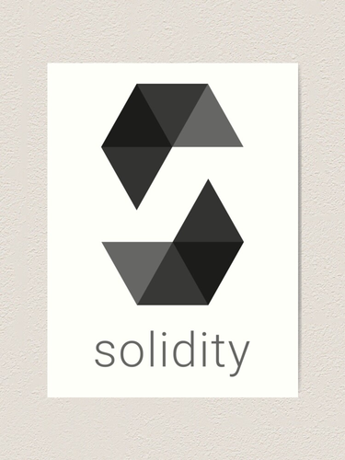
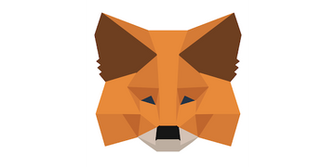
Our Products
Blockchain based Data management
Decentralized Database: Utilizes blockchain technology to create a tamper-proof and decentralized repository for verified healthcare information.
Data Integrity: Smart contracts ensure the accuracy and security of the contributed healthcare data, reducing the spread of misinformation.
Immutable Records: All healthcare information is recorded in an immutable ledger, preserving its integrity over time.
Secure Access: Provides secure and authenticated access to verified healthcare data for authorized users.

Slide 5

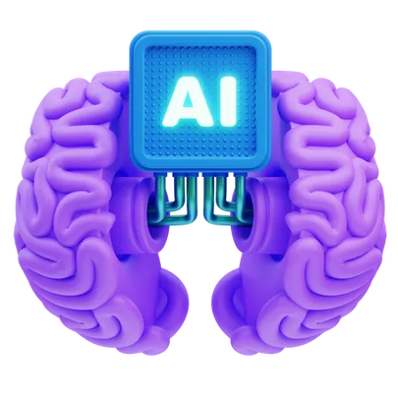
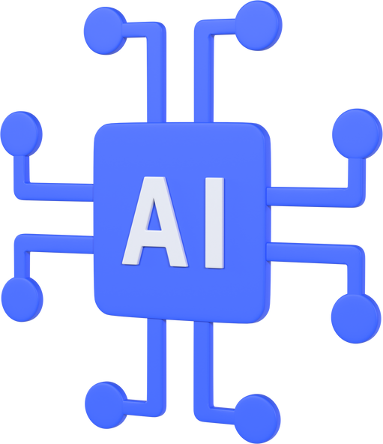
Our Products
Machine Learning based Prognosis
Symptom Selection: Patients can input their symptoms from a comprehensive list, allowing them to provide accurate and detailed information about their condition.
Ensemble Learning: Utilizes a combination of Random Forest, k-Nearest Neighbors (KNN), Decision Tree, and Naive Bayes algorithms to analyze the collected symptoms. This ensemble approach enhances accuracy and reliability in predicting potential medical conditions.
Personalized Predictions: Generates personalized prognosis reports based on the patient's symptom input, providing tailored insights into potential health issues and their severity.

Slide 6


Our services
Blockchain based Data Security
Disease Prognosis
One-Stop solution
Health Community
Developing an AI-driven chatbot or web application that uses machine learning to classify person’s disease according to his symptoms using 4 different models..
This technology implements views for both the doctors as well as the patients based on their authorization we can provide better healthcare infrastructure for the public domain.
Create a crowdsourced platform where healthcare professionals and informed individuals can collaboratively fact-check and verify health-related information.
Leverage blockchain technology to create a decentralized database of verified healthcare information. Patients, healthcare providers, and institutions can store data.

Slide 7
Technologies...!
Blockchain
By leveraging blockchain technology, we're creating an unbreakable chain of trust, empowering patients with control over their healthcare data and providing an impenetrable shield against data breaches to ensure that we have used Solidity along with Metamask wallet in this project
AI & ML
AI and ML are the cornerstones of our Healthcare Prognosis, as they enable rapid analysis of vast amounts of healthcare information and we have used Naive Bayes, Decision Tree Classifier and Gradient Boosting to make our project.
Full Stack
We have used gradio server to connect our clients as well as administrative officials to the app and the interface has implemented the use of HTML,CSS and JavaScript for building this application. Beside these we’ve elevated the backend with the help of Node.js and Next.js.

Slide 8
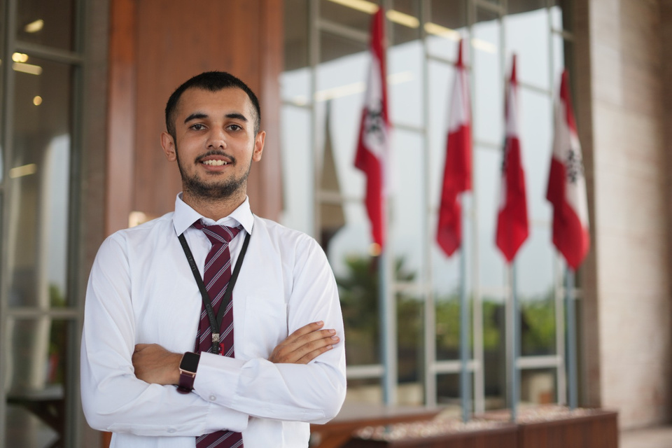
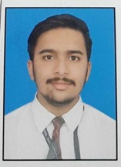
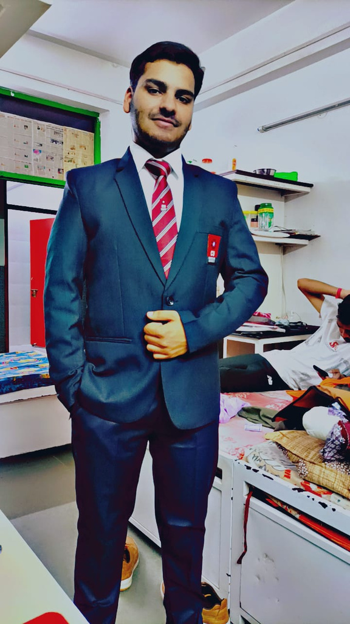
Our Team
Shreshth Sahay
Tarun Saroch
Sarthak Chauhan

Slide 9
Thank you

